Slide 1
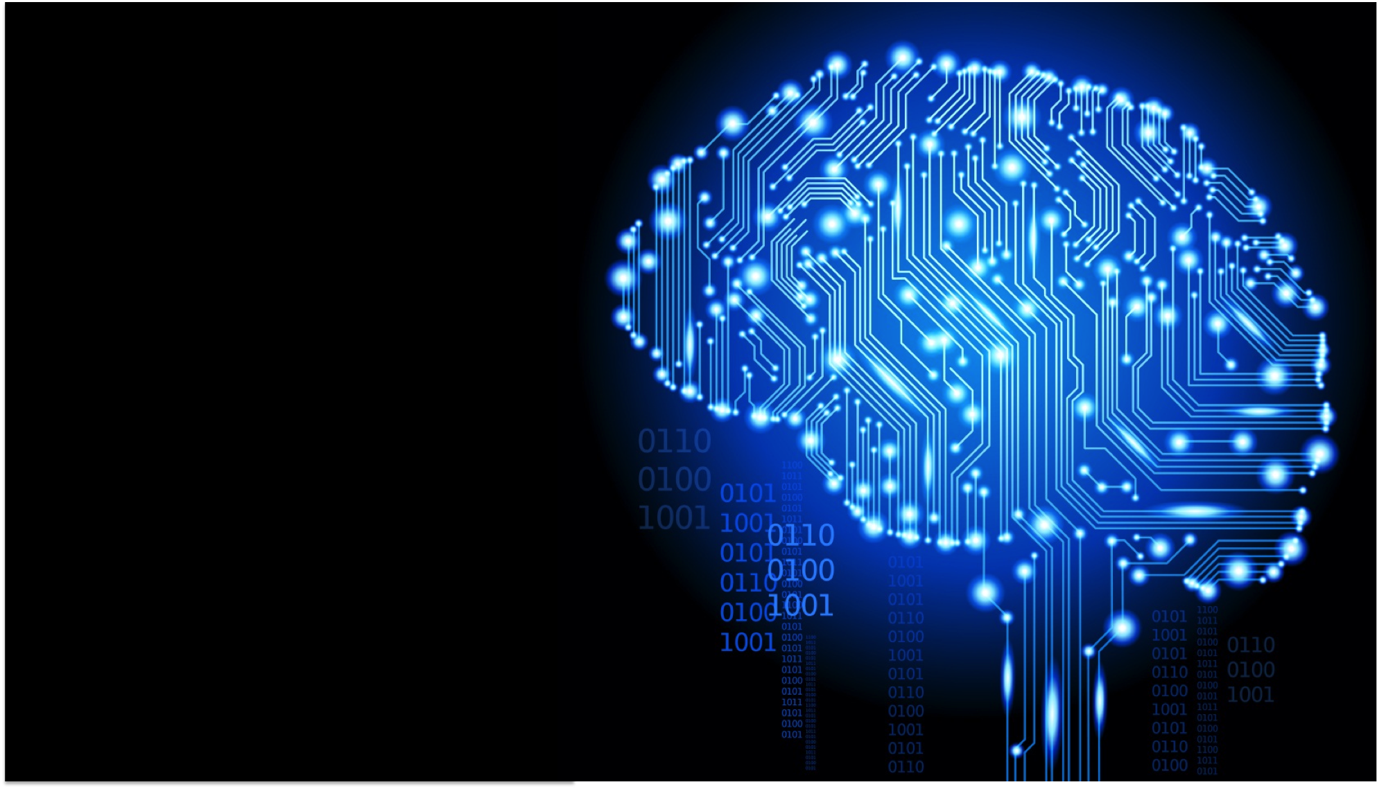
Disruptive Technologies

Slide 2
Agenda
What is Serverless Computing?
Architecture
Hands on Serverless Computing
What is AI , Machine Learning, Deep Learning?
Hands on Text Analytics
Applications of AI, Machine Learning and Deep Learning
Hands on Image Analytics
Hands on Voice Analytics

Slide 3


Slide 4
What is Serverless?
Serverless is about abstracting users away from servers, infrastructure, and having to deal with low-level configuration or the core operating system. Instead, developers make use of single purpose services and elastic compute platforms execute code.

Slide 5
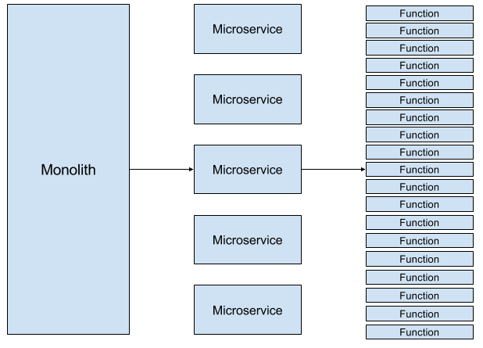

Slide 6
Principles of Serverless design
Use a compute service to execute code on demand
Write single-purpose, stateless functions
Design push-based, event-driven pipelines
Create thicker, more powerful front ends
Embrace third-party services

Slide 7

AWS Lambda
Serverless, event-driven compute service
Lambda = microservice without servers

Slide 8
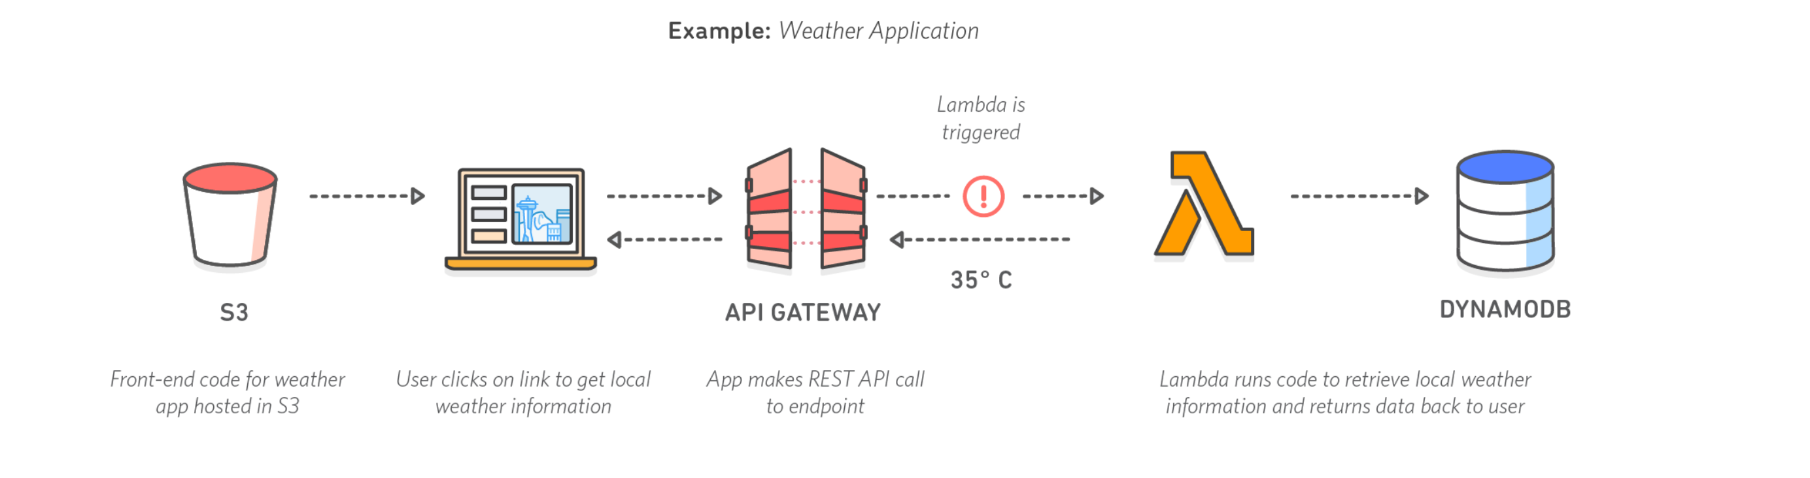
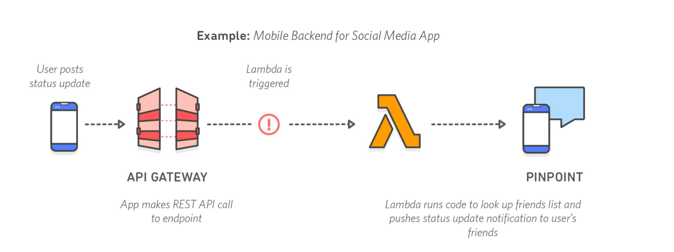
AWS Lambda

Slide 9




Advantages of Serverless technologies
No server Management
High availability
Flexible scaling
No idle capacity
Slide credit: D. Hoiem

Slide 10
Drawbacks of Serverless technologies
Vendor control
Multitenancy Problems
Vendor lock-in
Security Concerns
Repetition of logic across client platform
No in-server state for Serverless FaaS
Loss of Server optimizations
Implemantation
DoS yourself
Execution Duration
Startup Latency
Testing
Deployment / packaging / versioning
Discovery
Monitoring / Debugging
API Gateway definition, and over-ambitious API Gateways
Deferring of operations
Slide credit: D. Hoiem

Slide 11
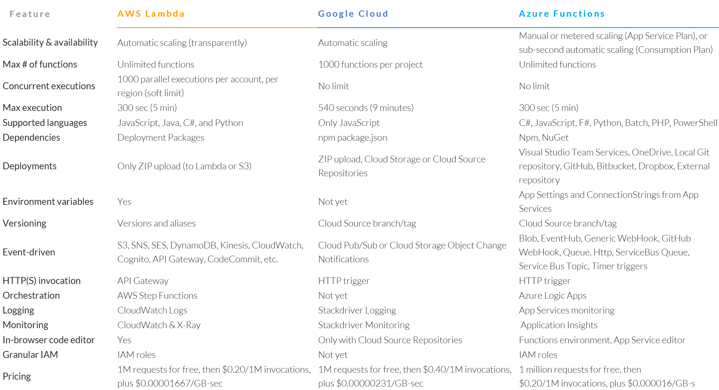
Serverless Compute Technologies

Slide 12
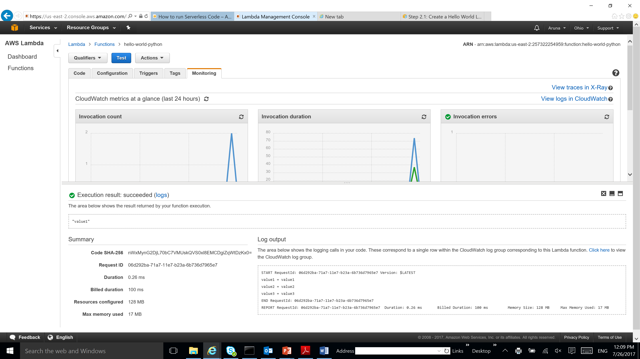
Notes:
https://us-east-2.console.aws.amazon.com/lambda/home?region=us-east-2#/functions?display=list

Slide 13
Artificial Intelligence

Slide 14
What has AI accomplished?
Autonomous planning & Scheduling
Game Playing
Autonomous Control
Diagnosis
Logistics Planning
Robotics
Language Understanding & Problem Solving

Slide 15
The Beginnings
1942 – Isaac Asimov publishes the three laws of robotics
1950 – Alan Turing publishes the Turing Test, a means of determining if a machine can think
1956 – The term Artificial Intelligence is coined at a meeting at Dartmouth College

Slide 16
Debating the question "Can machines think?"
The Argument from Informality of Behavior
It is not possible to produce a set of rules purporting to describe what a man should do in every conceivable set of circumstances. Thus it is not possible that humans are machines.
The Argument from Extrasensory Perception
Assuming the woman has ESP, she could perform better on a test of clairvoyance than the machine
Use a telepathy-proof room

Slide 17
Machine Learning

Slide 18

Machine Learning
The study of algorithms that learn from examples and experience instead of hard coded rules

Slide 19
Traditional Programming
Machine Learning
Data
Computer
Output
Program
Data
Computer
Program
Output

Slide 20
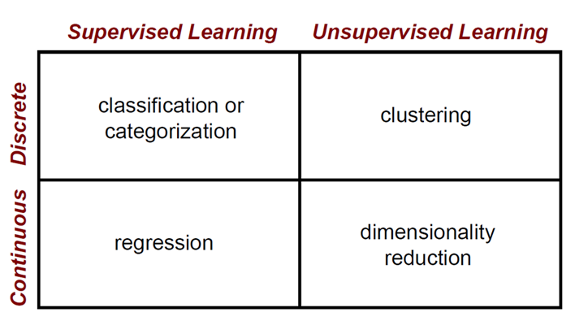
Machine Learning Problems

Slide 21
Clustering Strategies
K-means
Iteratively re-assign points to the nearest cluster center
Agglomerative clustering
Start with each point as its own cluster and iteratively merge the closest clusters
Mean-shift clustering
Estimate modes of pdf
Spectral clustering
Split the nodes in a graph based on assigned links with similarity weights
As we go down this chart, the clustering strategies have more tendency to transitively group points even if they are not nearby in feature space

Slide 22
Machine Learning Problems

Slide 23
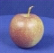
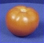
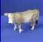
The machine learning framework
Apply a prediction function to a feature representation of the image to get the desired output:
f( ) = “apple”
f( ) = “tomato”
f( ) = “cow”
Slide credit: L. Lazebnik

Slide 24
The machine learning framework
y = f(x)
Training: given a training set of labeled examples {(x₁,y₁), …, (x_{N},y_{N})}, estimate the prediction function f by minimizing the prediction error on the training set
Testing: apply f to a never before seen test example x and output the predicted value y = f(x)
output
prediction function
Image feature

Slide 25

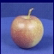
Steps
Training
Training Labels
Training Images
Image Features
Training
Learned model
Testing
Image Features
Learned model
Prediction
Test Image
Slide credit: D. Hoiem and L. Lazebnik

Slide 26

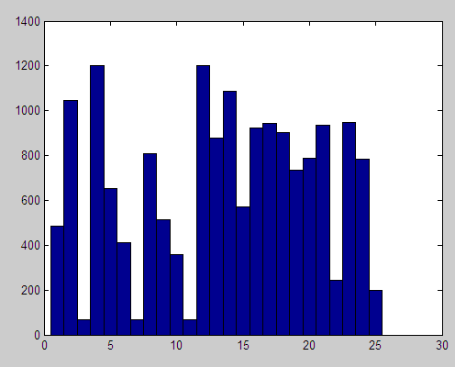

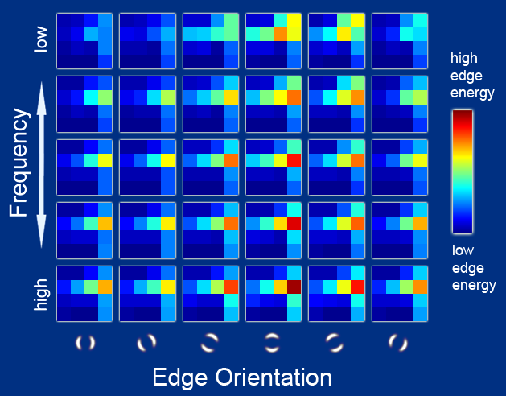
Features
Raw pixels
Histograms
GIST descriptors
…
Slide credit: L. Lazebnik

Slide 27
Classifiers: Linear
Find a linear function to separate the classes:
f(x) = sgn(w ⋅ x + b)
Slide credit: L. Lazebnik

Slide 28
Many classifiers to choose from
SVM
Neural networks
Naïve Bayes
Bayesian network
Logistic regression
Randomized Forests
Boosted Decision Trees
K-nearest neighbor
RBMs
Etc.
Which is the best one?
Slide credit: D. Hoiem

Slide 29
Generalization
Components of generalization error
Bias: how much the average model over all training sets differ from the true model?
Error due to inaccurate assumptions/simplifications made by the model
Variance: how much models estimated from different training sets differ from each other
Underfitting: model is too “simple” to represent all the relevant class characteristics
High bias and low variance
High training error and high test error
Overfitting: model is too “complex” and fits irrelevant characteristics (noise) in the data
Low bias and high variance
Low training error and high test error
Slide credit: L. Lazebnik

Slide 30
What to remember about classifiers
No free lunch: machine learning algorithms are tools, not dogmas
Try simple classifiers first
Better to have smart features and simple classifiers than simple features and smart classifiers
Use increasingly powerful classifiers with more training data (bias-variance tradeoff)
Slide credit: D. Hoiem

Slide 31
Deep Learning
Notes:
https://

Slide 32
Deep Learning Revolution
Notes:
https://www.youtube.com/watch?v=Dy0hJWltsyE

Slide 33
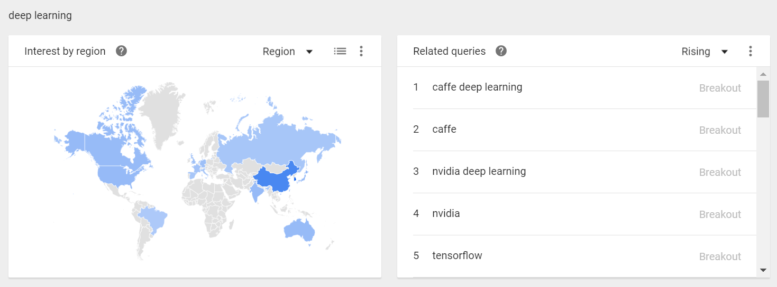
Deep Learning Trends
Notes:
https://

Slide 34
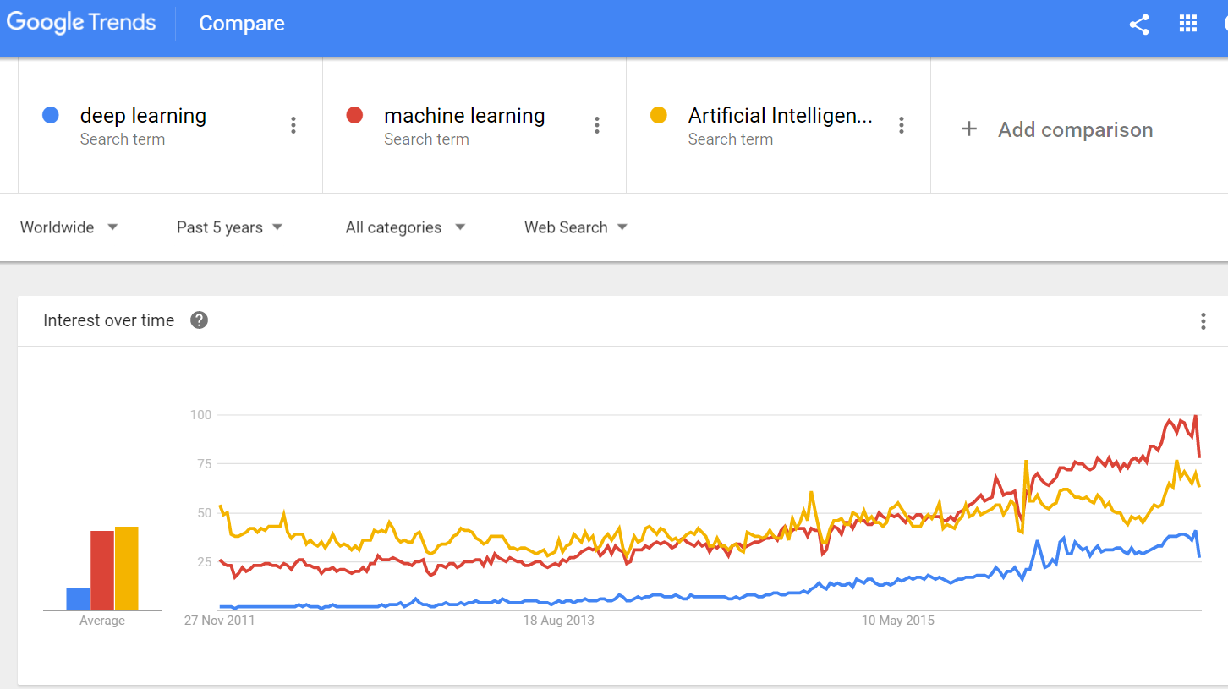
Deep Learning Trends

Slide 35


Artificial Intelligence Groups

Slide 36
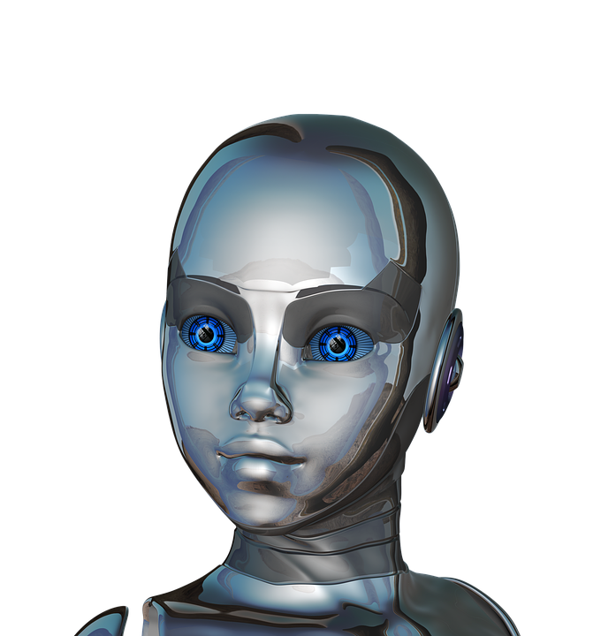
Deep Learning
Deep learning is a branch of machine learning which uses data and enables machines to perceive like humans do.

Slide 37

Neuron
From Wikipedia
A neuron (/ˈnjʊərɒn/ nyewr-on or /ˈnʊərɒn/ newr-on, also known as a neurone^{[1]} or nerve cell) is an electrically excitable cell that processes and transmits information through electrical and chemical signals. These signals between neurons occur via synapses, specialized connections with other cells. Neurons can connect to each other to form neural networks.

Slide 38
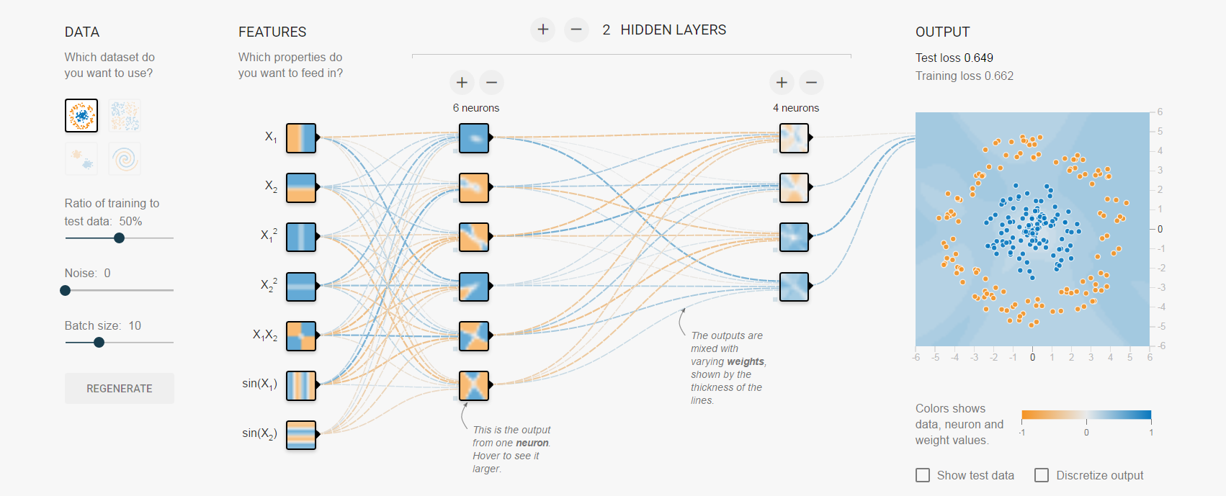
Neural Network

Slide 39



Applications

Slide 40
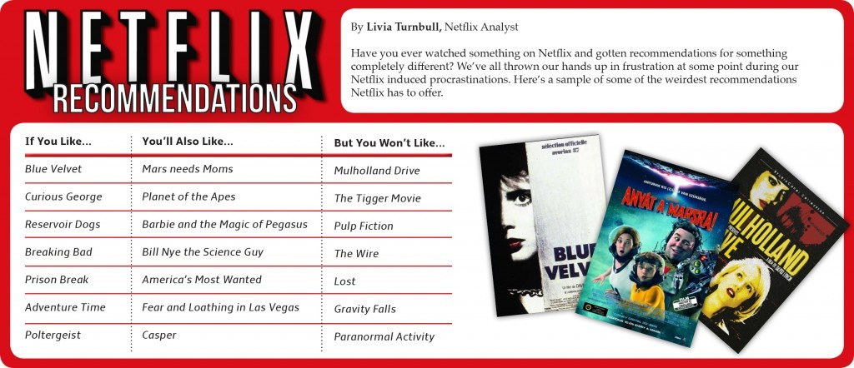

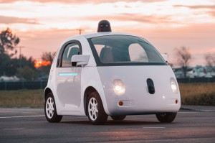
AI/ ML / DL Applications

Slide 41

Computer Vision

Slide 42
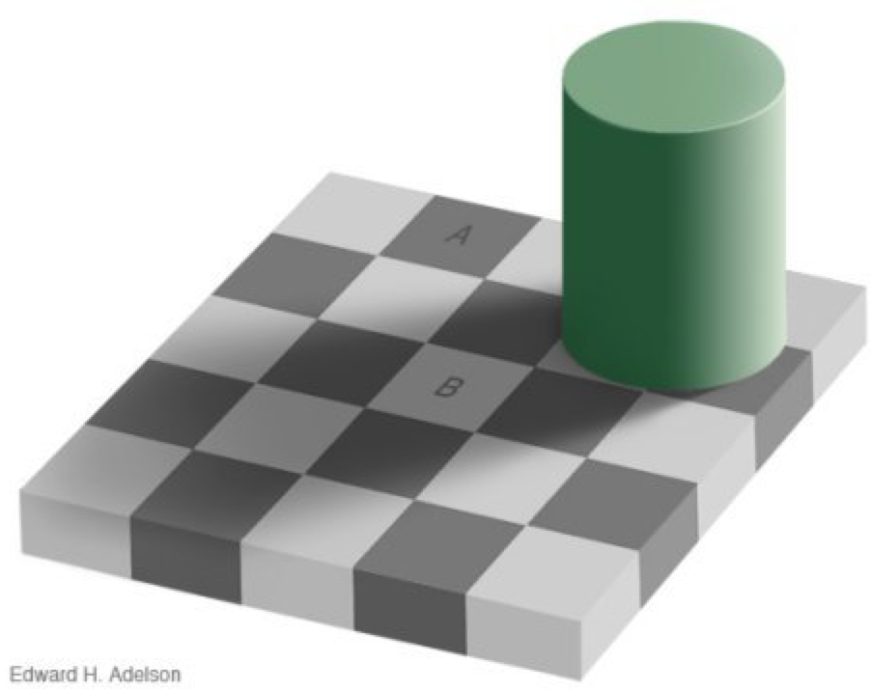

Slide 43
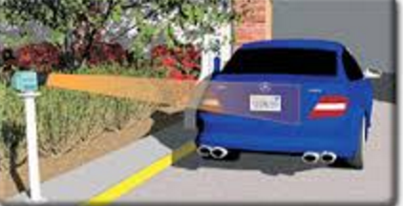
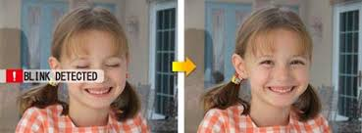
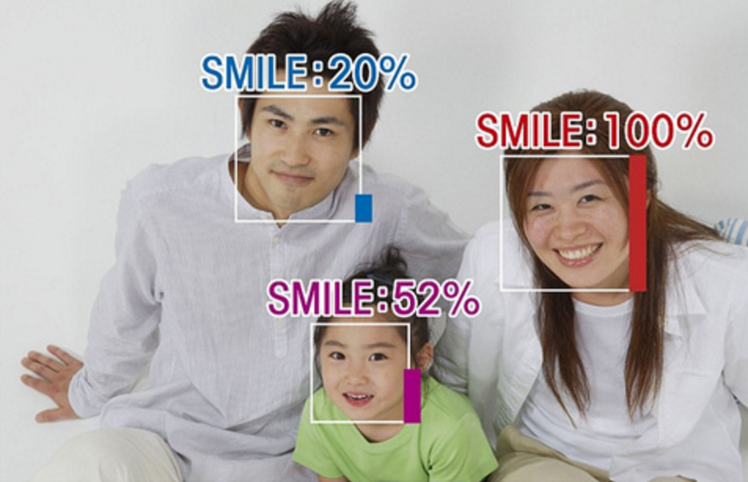
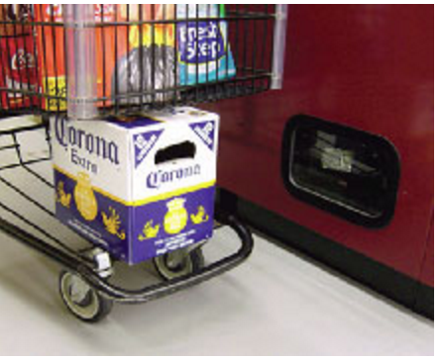
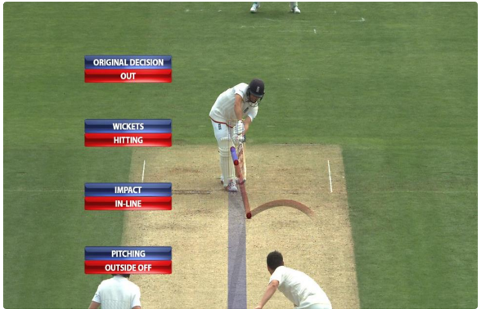

Slide 44
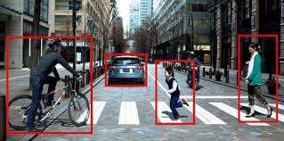

Slide 45
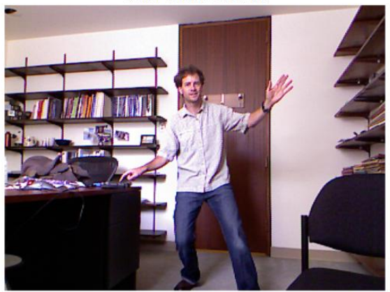
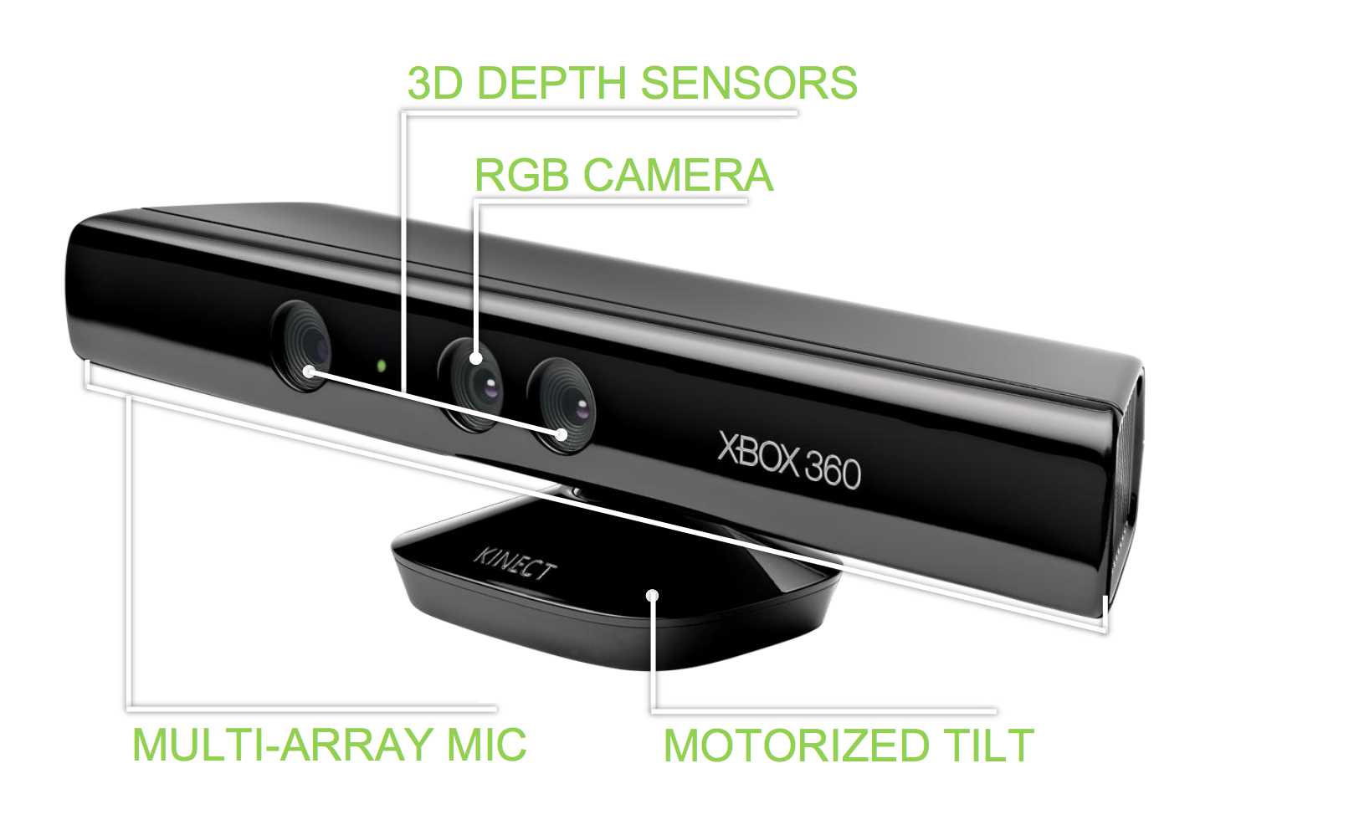
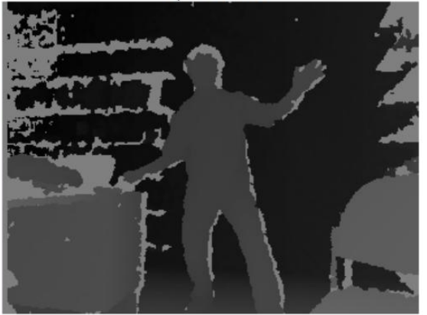
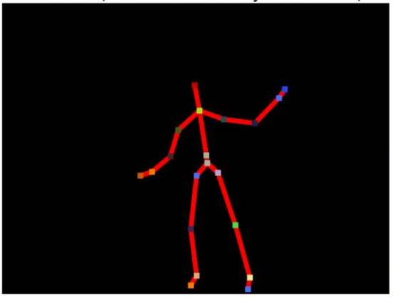

Slide 46
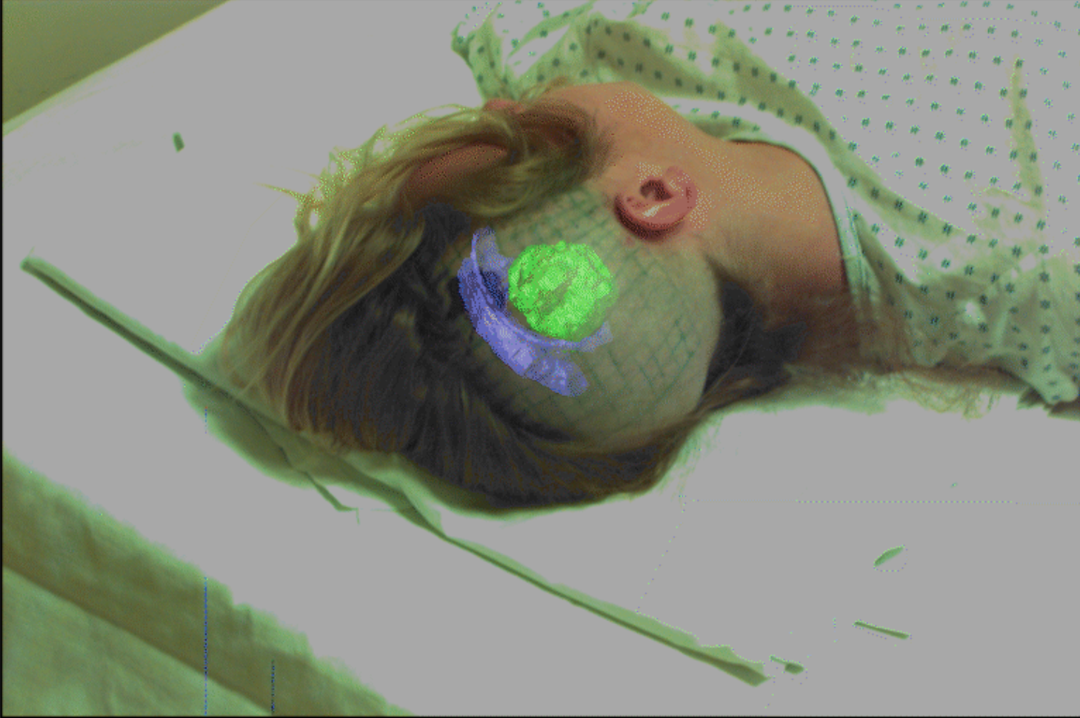

Slide 47



Slide 48
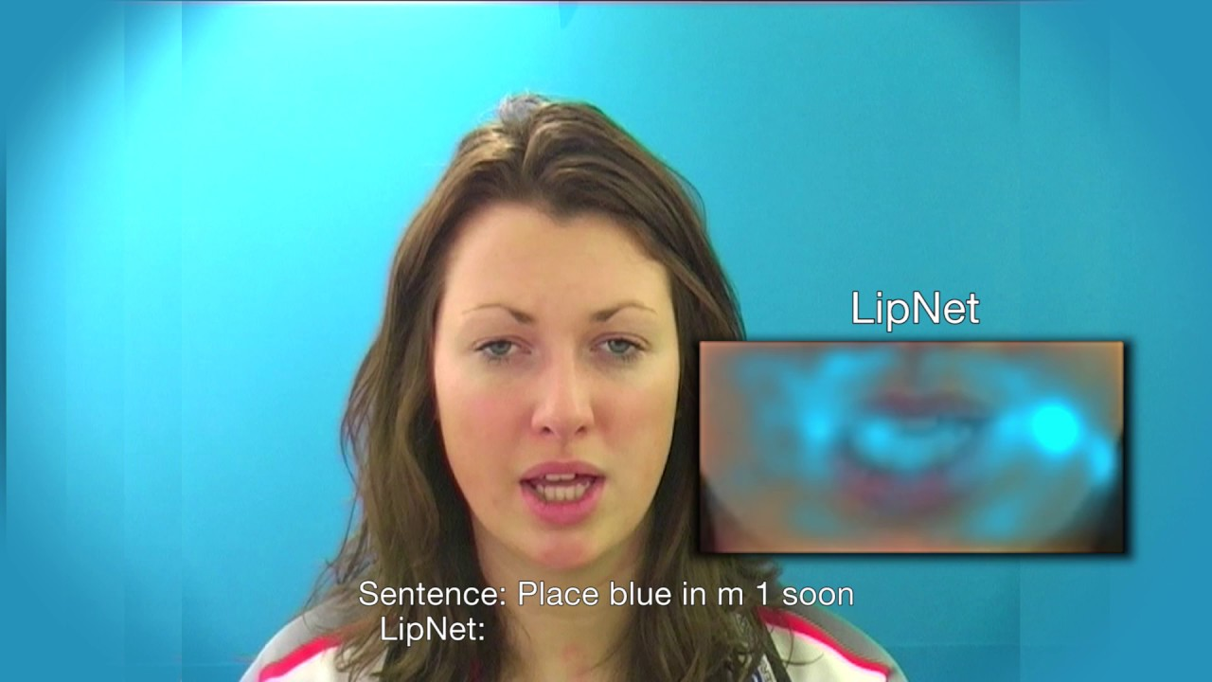

Slide 49
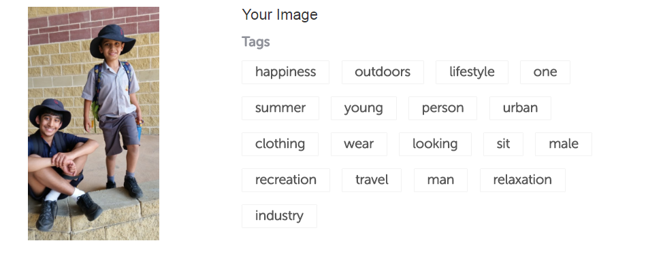

Slide 50
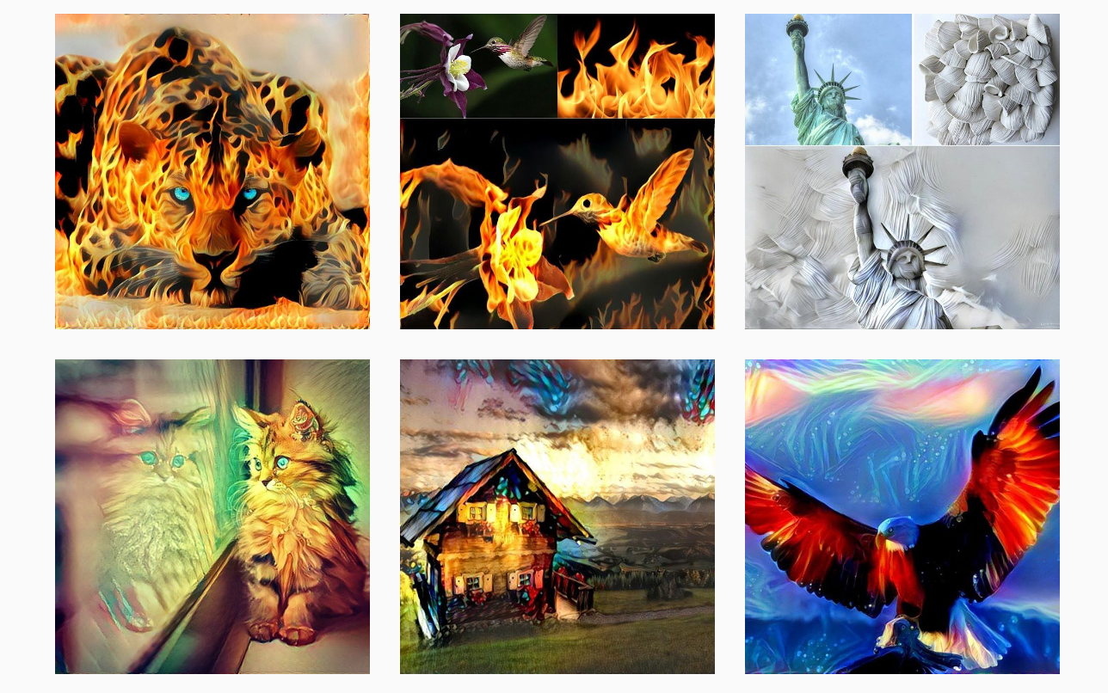

Slide 51
Computer Vision

Slide 52

App recognising a flower
def detect_petal _length
def detect_petal_shape
def detect_color
def detect_curvature
………………………….
…………………………..

Slide 53




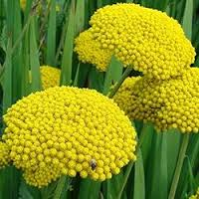

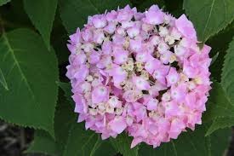

What about these

Slide 54
Machine Learning
Collect the data
Pick the Model
Train the Model
Test the Model
Data + Model
=
Pattern Recognition

Slide 55
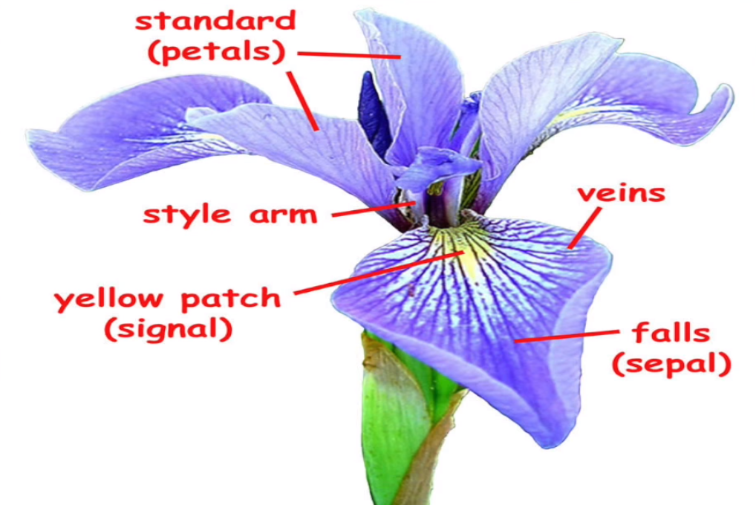
Iris Flower Recognition App

Slide 56


Build the app

Slide 57
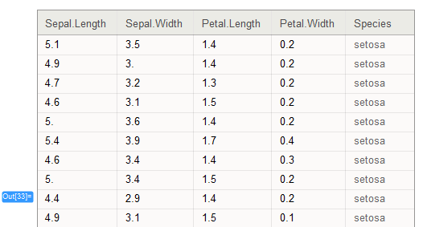
Coding the app
import tensorflow.contrib.learn as skflow
from sklearn import datasets, metrics
# Collect the data

Slide 58
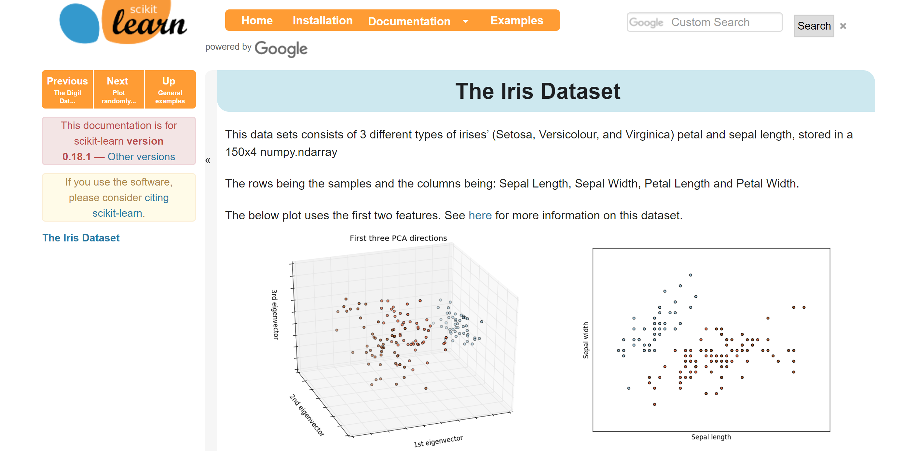
Scikit Learn Iris Dataset

Slide 59
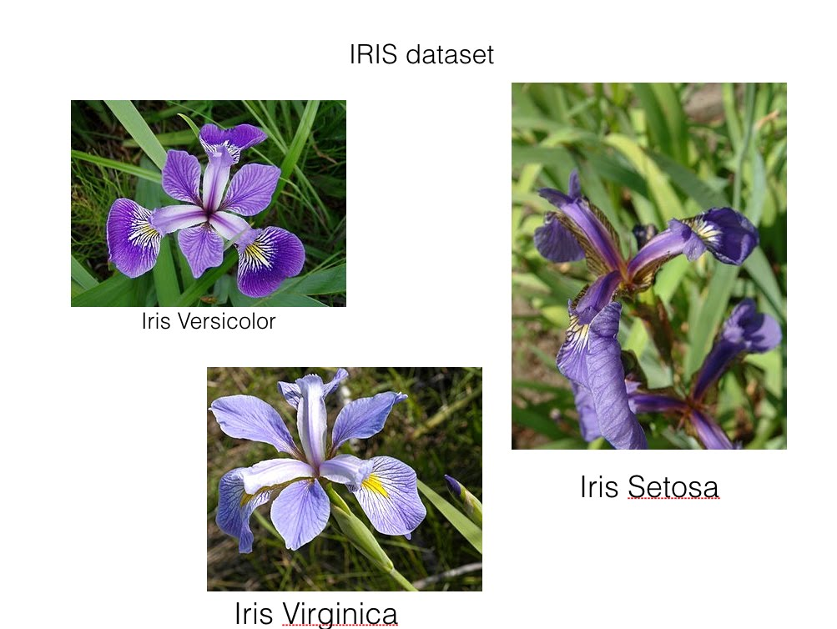
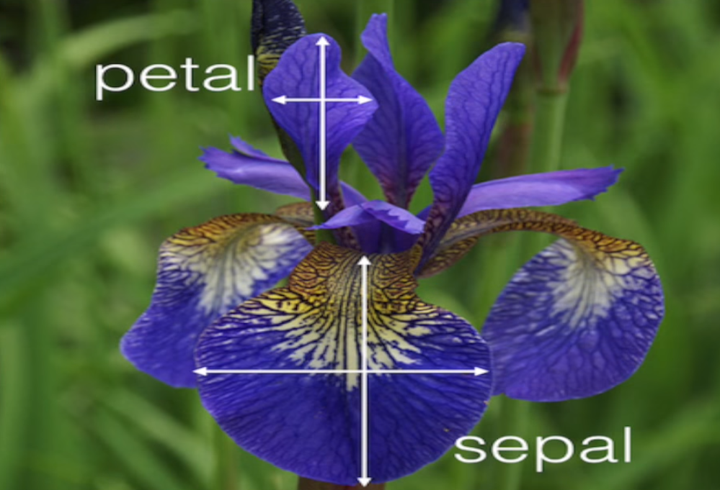
Coding the app
import tensorflow.contrib.learn as skflow
from sklearn import datasets, metrics
# Collect the data
Iris = datasets.load_iris()

Slide 60
Coding the app
Supervised Learning
import tensorflow.contrib.learn as skflow
from sklearn import datasets, metrics
# Collect the data
Iris = datasets.load_iris()
Label

Slide 61
Coding the app
Features
Petal Length
Petal Width
Sepal Length
Sepal Width
Good Features
Simple
Independent
Informative

Slide 62
Coding the app
import tensorflow.contrib.learn as skflow
from sklearn import datasets, metrics
# Collect the data
Iris = datasets.load_iris()
# Pick the model

Slide 63
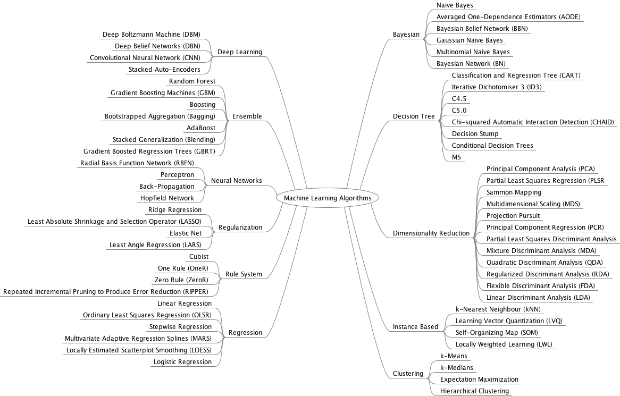
Pick the model

Slide 64

Pick the model

Slide 65
Coding the app
import tensorflow.contrib.learn as skflow
from sklearn import datasets, metrics
# Collect the data
iris = datasets.load_iris()
# Pick the model
classifier = skflow.TensorFlowLinearClassifier(n_classes=3)
#classifier = skflow.TensorFlowDNNClassifier(hidden_units=[10,20,10], n_classes=3)
# Train the model
classifier.fit(iris.data,iris.target)
score = metrics.accuracy_score(iris.target,classifier.predict(iris.data))
Print(“Accuracy: %f” % score)

Slide 66
Natural Language Processing

Slide 67
Natural Language Processing
Psychology and Sociology
Study of People
Emotions
Relationships
Behaviour

Slide 68


Sentiment Analysis
Tokenisation
Input Text
Split Text
Identify
Subject
Verb
Object

Slide 69

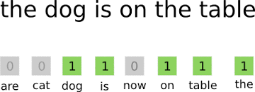
Sentiment Analysis

Slide 70
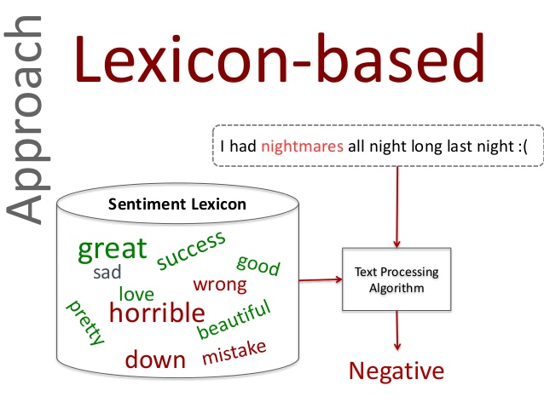
Sentiment Analysis

Slide 71
Sentiment Analysis
Register for Twitter API
Install Dependencies
Write our script

Slide 72
Sentiment Analysis
import tweepy
from textblob import TextBlob
consumer_key='MwMCxvCp596RpPnS3u8kLYzJ1'
consumer_secret='Gtxbl8qzM6fYNr3SHGPApnz3ZpmEHs7k7WwOnuaezeBWEUWCVI‘
access_token='19697843-GhphjzWWsnJmXdy6btdqNBnXuz19dkkugHnSDFPnS'
access_token_secret='Vu2NQJz7UyeR3ou1yIfA3wGGdkP1sDbYv8276DaJ6UjDb‘
auth = tweepy.OAuthHandler(consumer_key, consumer_secret)
auth.set_access_token(access_token, access_token_secret)
api = tweepy.API(auth)
public_tweets = api.search('Trump')
for tweet in public_tweets:
print(tweet.text)
analysis = TextBlob(tweet.text)
print(analysis.sentiment)

Slide 73
Sentiment Analysis
Sentiment Analysis – Understanding and Extracting Feelings from the data
An API lets you access an apps functionality from your code.
Text Blob python library performs sentiment analysis in few lines of code.

Slide 74
Speech/Voice Analysis

Slide 75
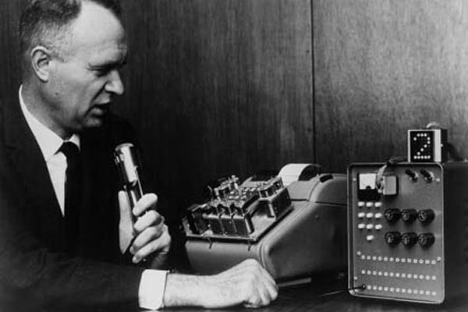
Speech Recogniser

Slide 76
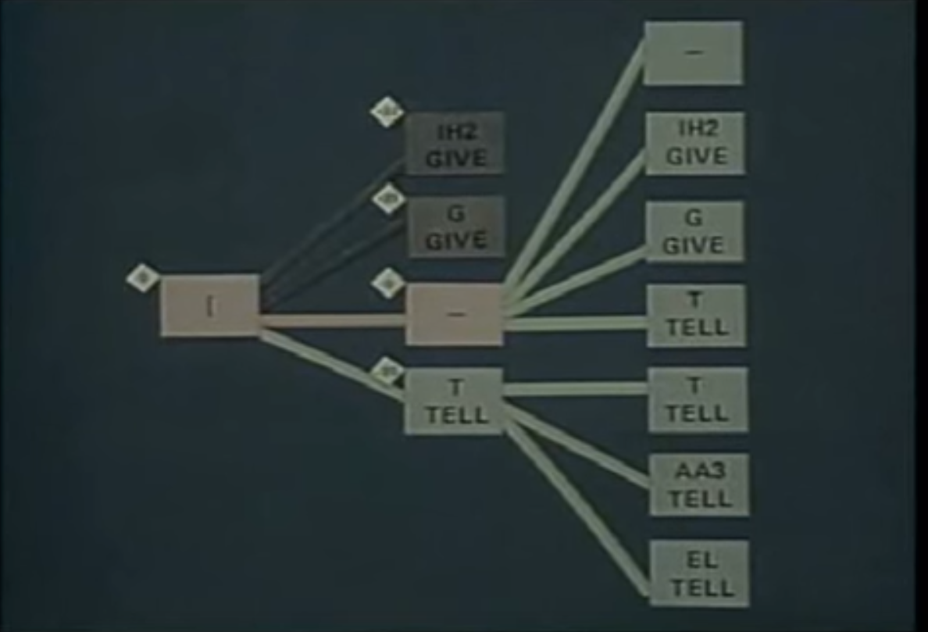
DARPA Harpy

Slide 77



Speech Recognition Systems

Slide 78
Recognising spoken numbers
Download Dataset
Build Neural Network
Train the Model
Test the Model

Slide 79
Coding the app
import tflearn
import speech_data
# Hyperparamaters , need to check the time vs accuracy while choosing the learning_rate
learning_rate = 0.0001
training_iters = 300000
batch = word_batch =speed.data.mfcc_batch_generator(64)
X, Y = next(batch)
trainX,trainY = X,Y
testX, testY,X,Y
net = tflearn.input_data([None,20,80])
net = tflearn.lstm(net, 128, dropout=0.8)

Slide 80
Coding the app
net = tflearn.fully_connected(net, 10, activation=‘softmax’)
net = tflearn.regression(net, optimiser=‘adam’,, activation=‘softmax’, learning_rate=learning_rate, loss= categorical_crossentropy)
model = tflearn.DNN(net, tensorboard_verbose=0)
while 1:
model.fit(trainX, trainY, n_epoch=10, validation-set=(testX, testY), show_metric=True, batch_size=64)
_y=model.predict(x)
model.save(‘tflearn.lstm.model’)
print(_y)
print(y)

Slide 81
Summary
LSTM networks offer state of the art speech recognition
TFLearn helps you build neural networks fast
Hyperparameters are all about balance
Test the Model

Slide 82
What we have learnt
Serverless Computing
AI ,
Machine Learning
Deep Learning
Hands on Text Analytics
Hands on Image Analytics
Hands on Voice Analytics

